Slide 1
Favorites DataBase *For the nosey*
Sarah Deris

Slide 2
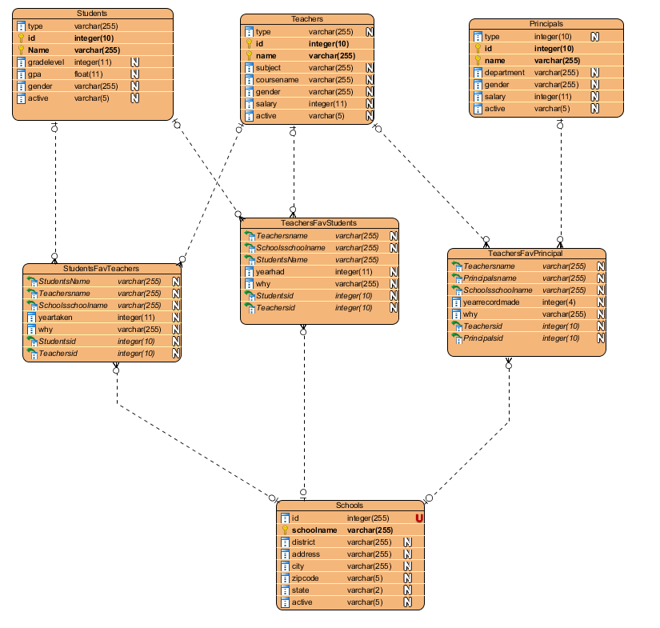
Er diagram
DB consists of tables of
Students
Teachers
Principals
Schools
Students Favorite Teachers
Teachers Favorite Students
Teachers Favorite Principals

Slide 3
Views, Function, Procedure, trigger
*Four views to see inactive teachers, students, principals, schools.
*Function for retrieving the number of 5 star ratings a teacher has.
*Procedure for learning more about a student’s favorite teachers.
*Trigger for whenever a teacher is inserted into the DB, their salary increases by $2000.

Slide 4
Normalization
*4th normal form

Slide 5
Integrity
* Foreign keys were used in the favorites table. They referenced Schools, Teachers, Students, and Schools table.

Slide 6
Isolation
*Repeatable Read

Slide 7
http://sarahd1.sgedu.site/favoriteproject/menu.php

